Slide 1
Transport Layer

Slide 2
Transport layer acts as a liaison between the upper-layer protocols and the lower-layer protocols.
  TCP, UDP.
The transport layer is responsible for process-to-process delivery.

Slide 3
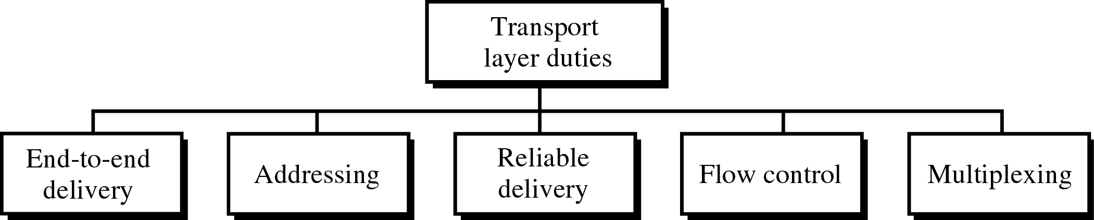
Transport Layer Role and Services
Transport Layer Services

Slide 4

Types of data deliveries

Slide 5

Port numbers

Slide 6

IP addresses versus port numbers

Slide 7

IANA (Internet Assigned Number Authority)
ranges
23.<number>

Slide 8

Well-known ports used by TCP

Slide 9


Well-known ports used by UDP

Slide 10

Socket Address
23.<number>

Slide 11

Multiplexing and Demultiplexing
23.<number>

Slide 12

Error control

